Slide 1
CS 478 – Tools for Machine Learning and Data Mining
Clustering Quality Evaluation
Notes:
Fall 2004
CS478 - Machine Learning

Slide 2
Quality Metrics
External metrics
  Computed from a comparison to actual clustering (or classification) labels.
Internal metrics
  Computed solely from the composition of a cluster, with no recourse to external information.

Slide 3
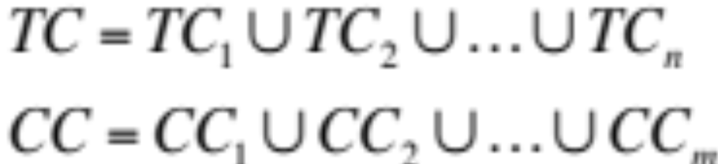
External Metrics – Setup (I)
Let:
be the target and computed clusterings, respectively.
TC = CC = original set of data
Define the following:

Slide 4
External Metrics – Setup (II)
a: number of pairs of items that belong to the same cluster in both CC and TC
b: number of pairs of items that belong to different clusters in both CC and TC
c: number of pairs of items that belong to the same cluster in CC but different clusters in TC
d: number of pairs of items that belong to the same cluster in TC but different clusters in CC

Slide 5
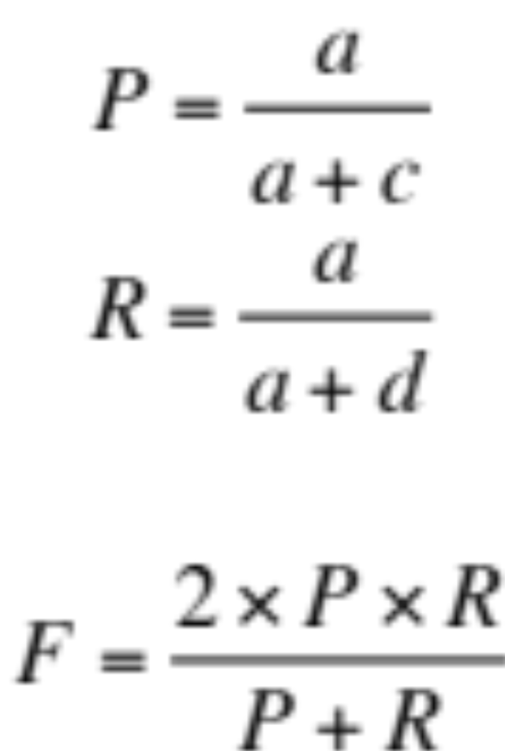
F-measure

Slide 6
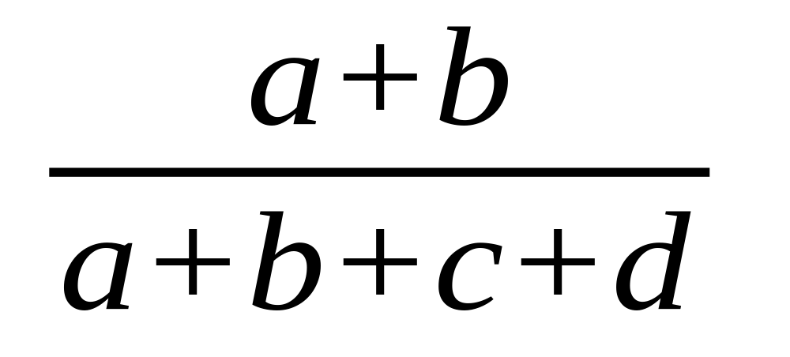
Rand Index
Measure of clustering agreement: how similar are these two ways of partitioning the data?

Slide 7
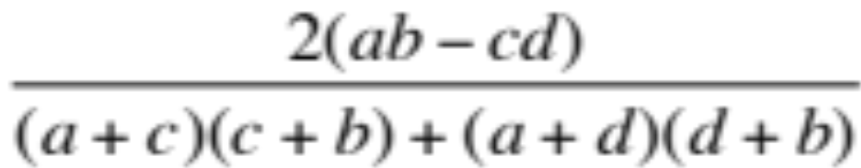
Adjusted Rand Index
Extension of the Rand index that attempts to account for items that may have been clustered by chance

Slide 8
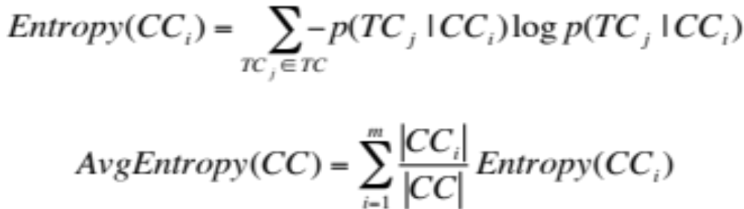
Average Entropy
Measure of purity with respect to the target clustering

Slide 9
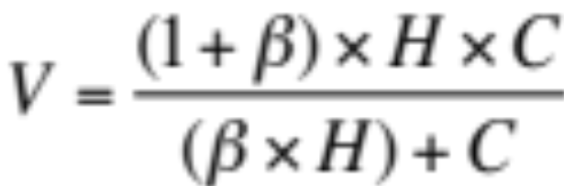
V-measure
Entropy-based
Combines:
  Homogeneity (H): all computed clusters contain only items which are members of the same target cluster/class
  Completeness (C): all data items of a given target cluster/class are in the same computed cluster

Slide 10
Internal Metrics
Assume no target clustering
Attempt to capture some intrinsic properties of the clustering
  Distance-based
    Sum of all squares
    Diameter sum or maximum
    Sum of minimum distance between clusters, etc.
  Probability-based
    E.g., KL divergence

